Slide 1
NBA Report Management system
AIDM7360 Group: 德莱联盟
Chen Cang 20439369 Ge Qichao 20461313
Ma Min 20466455 Zhao Xingxu 20431015

Slide 2
Introduction
We want to output the following report through NBA Report Management System:
The performance of Lakers and James in one game and their comparison with the average performance in the entire regular season;
The comparison between James' performance in one game and his average performance when the Lakers won or lost;
In the 2019-2020 season, the Bucks was the team with the highest winning percentage in the entire regular season, and the Heat was the opponent of the Lakers in the finals. Both of them are very competitive, so we want to compare James’s performance with the performance of Bucks and Heat top players;

Slide 3
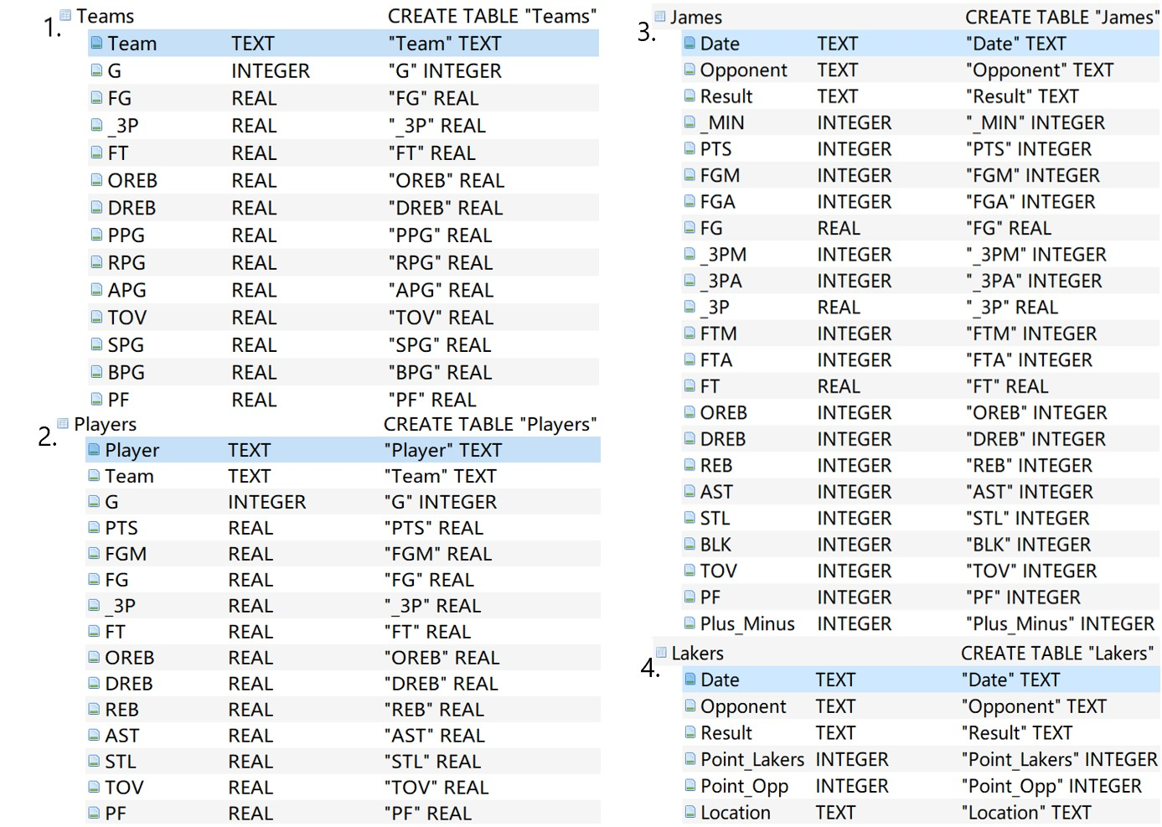
Data
We import the dataset (csv files) into the database
4 tables: Teams, Players, James, Lakers
The primary key for each table
is
the attribute in blue color.
Teams.Team
Players.Player
James.Date
Lakers.Date

Slide 4
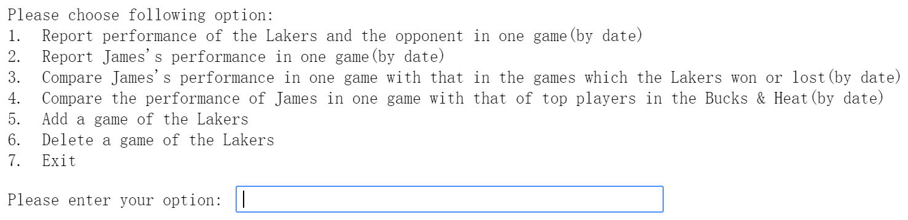
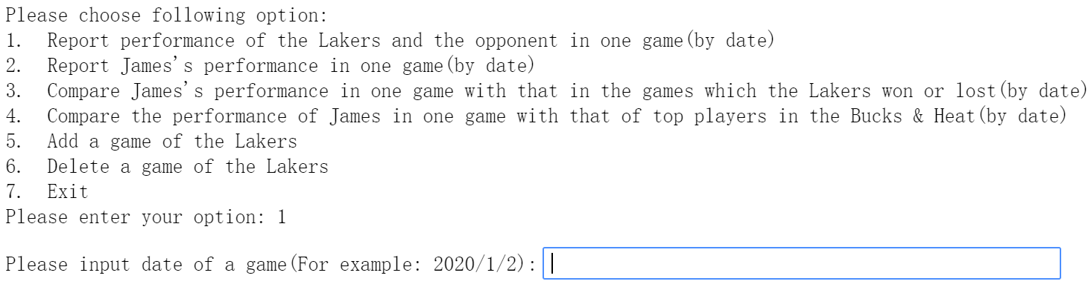
Interface
There are 6 functions in our NBA Report Management System
Including insertion, query and deletion (options 1 to 4 are queries of data, 5 is insertion, and 6 is deletion)
After entering the option, you can input the date:

Slide 5
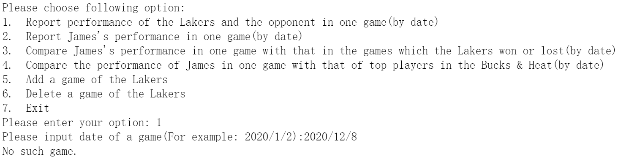
Option 1: Report performance of the Lakers & the opponent
If there was no game of the Lakers, the system will prompt “No such game.”:
If there was, the system will report:

Slide 6
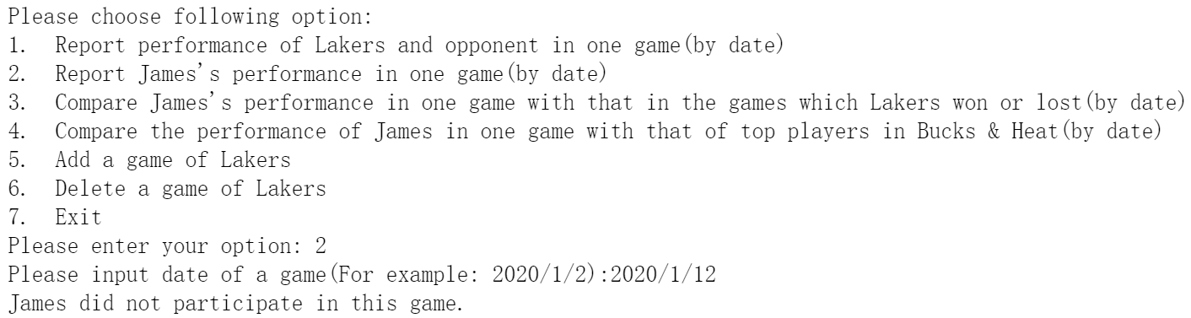
Option 2: Report James’s performance in one game
If James didn’t participate, the system will prompt “James did not participate in this game.”:
If James did, the system will report:

Slide 7
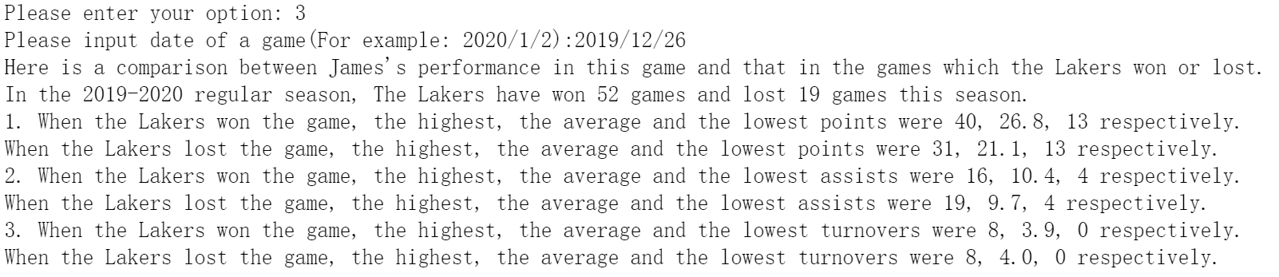
Option 3: Compare James’s performance with that in games which the Lakers won or lost
After inputting the date
The format is :
Lakers total wins, total losses.
Comparison of points
Comparison of assists
Comparison of turnovers

Slide 8
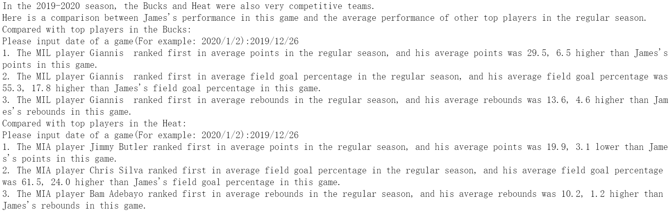
Option 4: Compare the performance of James in one game with that of top players in the Bucks & Heat
After inputting the date

Slide 9


Option 5: Add a game of the Lakers
Inputting as the following format to insert, the system will prompt “Succeed to add game!!!”
Option 6: Delete a game by inputting a date
Inputting a date, the system will prompt “Succeed to delete game!!!”

Slide 10
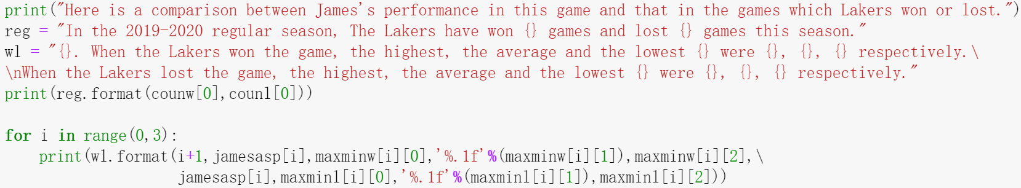
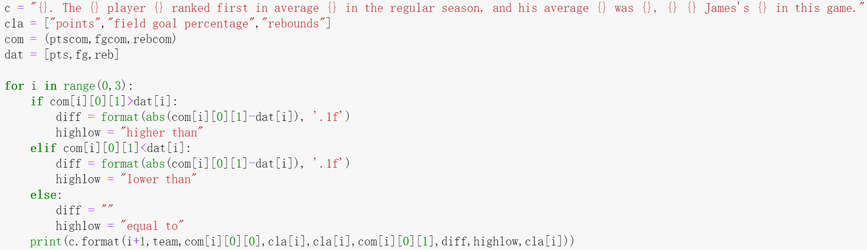
Templates & SQL Queries
Our SQL queries apply subquery and aggregate functions, here are some parts:
We reuse some templates for no less than three times, here are some examples:

Slide 11
Data Analysis & Visualization mainly focusing on option 3 & 4
Option 3: Compare James’s performance in one game with that in the games which Lakers won or lost
Option 4: Compare the performance of James in one game with that of top players in Bucks & Heat

Slide 12
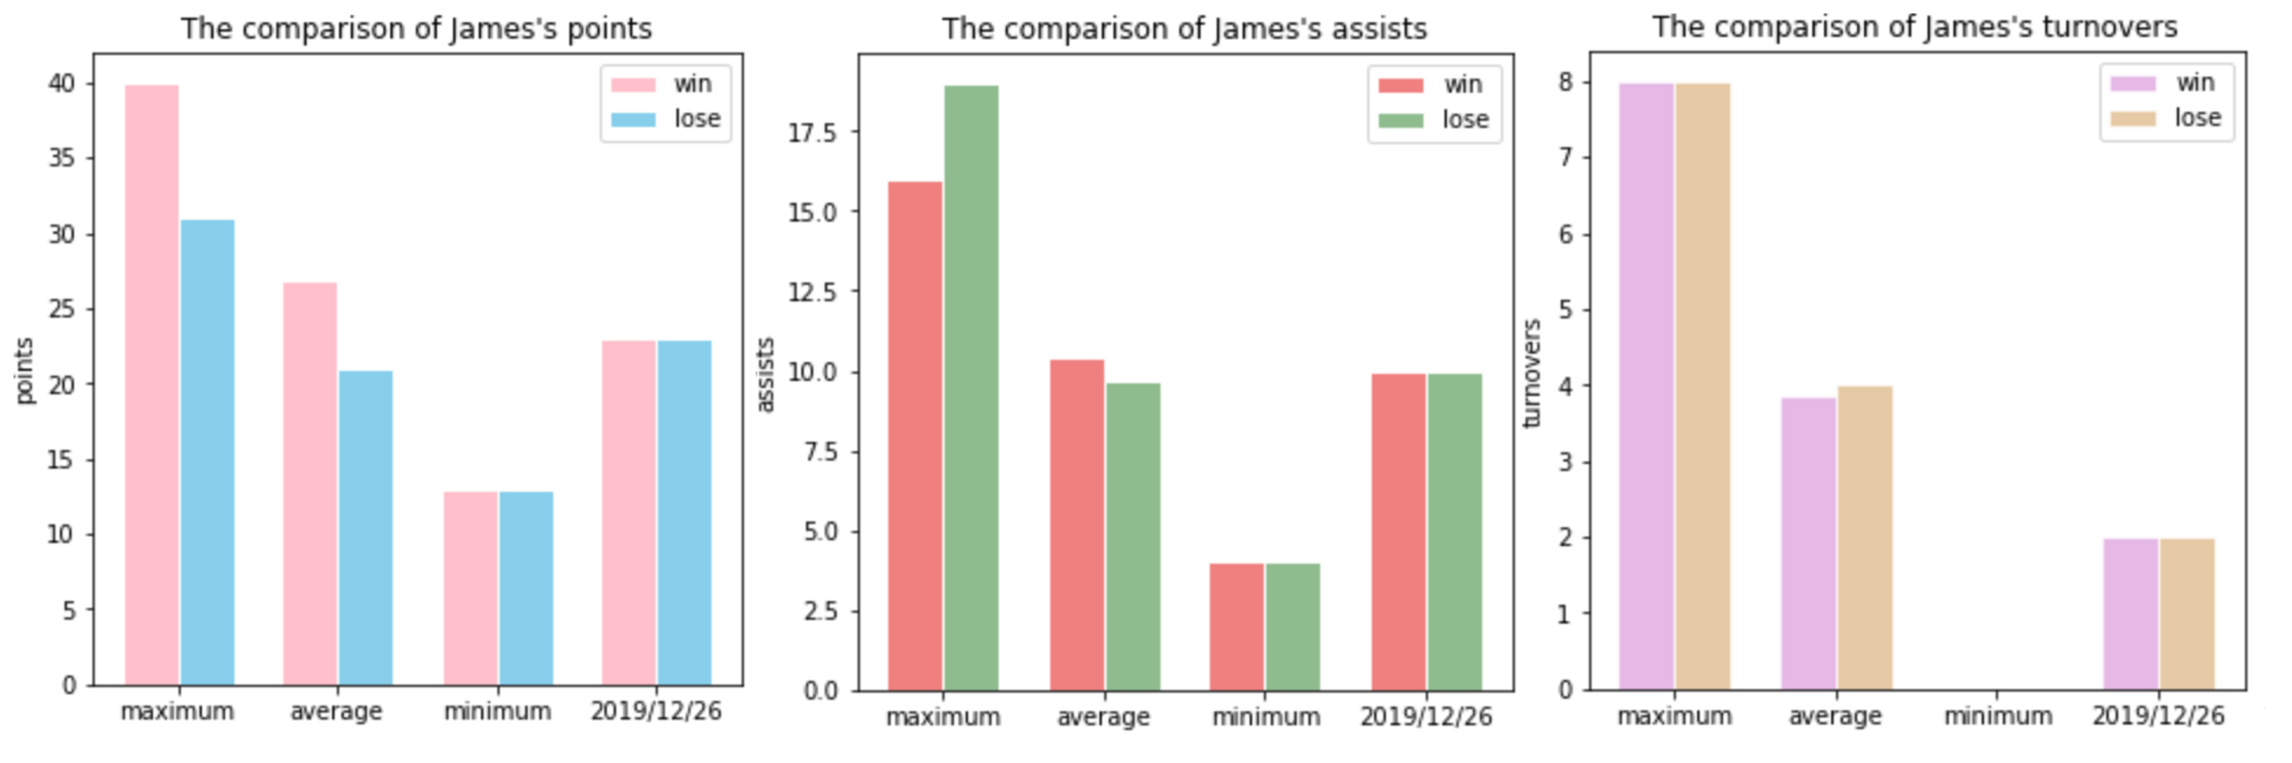
Compare James’s performance in one game with that in the games which Lakers won or lost
James’ scoring played a key role in whether the Lakers won. The higher James’s points, the Lakers was more likely to win. In 2019/12/26, the Lakers lost the game, in which James scored more than 20 points, between “win_average” and “lose_average”.
In terms of assists, James performed better when the Lakers lost, which may need to further explored. In the game on 2019/12/26, the number of James’ assists were basically equal to that of the average assists in the regular season.
Regarding turnovers, James' performance was almost the same when the Lakers won and lost.

Slide 13
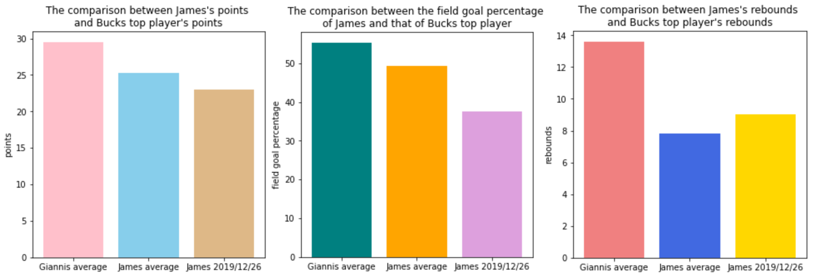
Compare the performance of James in one game with that of top players in the Bucks
In 2019-2020 regular season, the player in Bucks who ranked first in points, field goal percentage, and rebounds was Giannis. In the game on 2019/12/26, there was still a gap between James’ performance and Giannis average performance in the regular season.

Slide 14
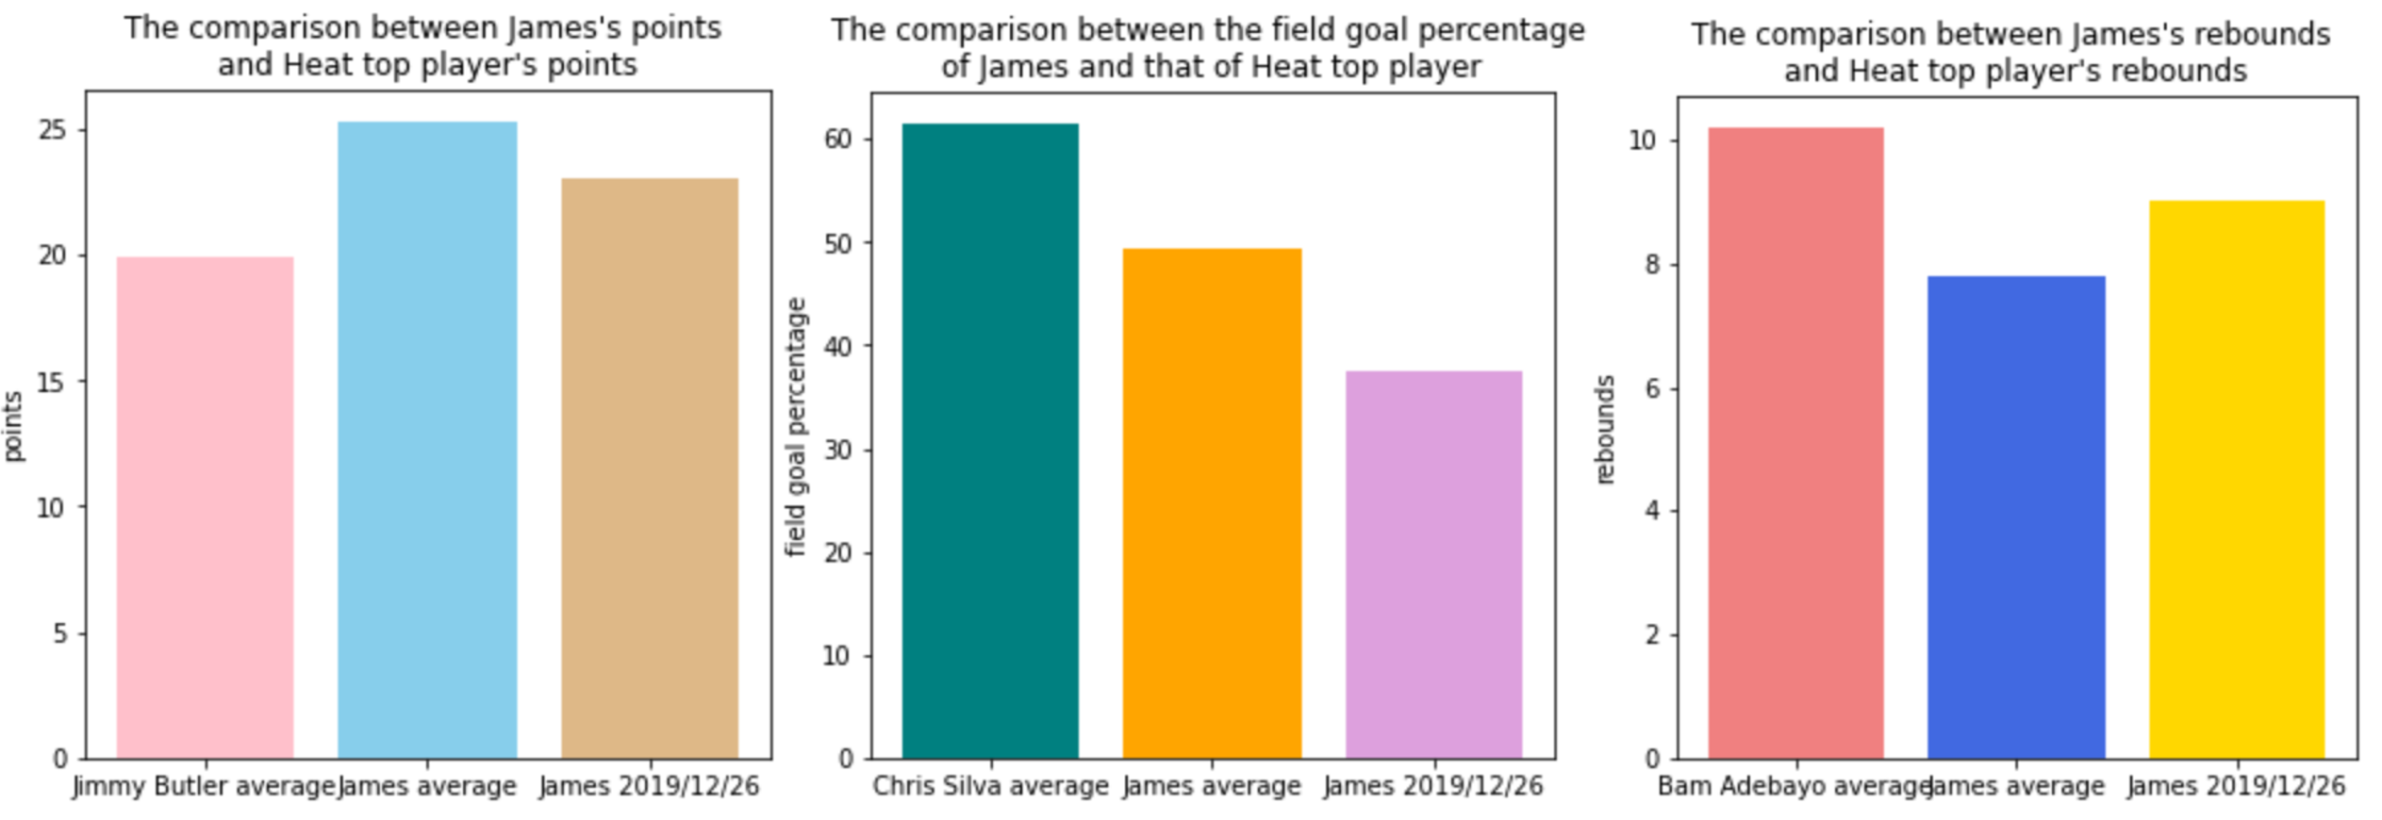
Compare the performance of James in one game with that of top players in the Heat
In the game on 2019/12/26, James scored lower than his average points in the regular season, but higher than the average points of Jimmy Butler who ranked first in the Heat.
The field goal percentage of James was not only lower than his average in the regular season, but also much lower than that of Chris Silva who ranked first in the Heat.
In this game, James performed good in rebounds, only one rebounds lower than Bam Adebayo who ranked first in the Heat.

Slide 15
Maybe
we have found the reason why the Lakers lost the game on 2019/12/26.
If James did a better job in scoring and field goal percentage, the result of this game might have changed.
Thank you!!

